Slide 1
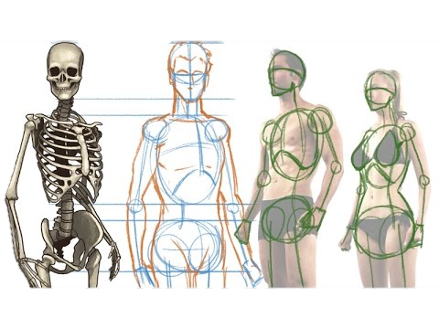

^{building} Teachers from Above ^{James 3}
pure
wise
considerate
considerate
submissive
sincere
impartial
Peace loving
Good
life
Not
boastful
merciful
Pastor Johnson Hsu
humble

Slide 2



Examine the text (‘exegesis’)
Application to our live

Slide 3
Written to a Jewish background audience: “To the twelve tribes scattered among the nations” ^{James 1:1}
These are already followers of Jesus: “Believers in humble circumstances…” ^{James 1:9}
  This is not about being saved, but how to live now that we are saved
The ‘scattering’ may be the aftermath of the persecution in Acts: “Now those who had been scattered by the persecution that broke out when Stephen was killed traveled as far as Phoenicia, Cyprus and Antioch, spreading the word only among Jews.” ^{Acts 11:19}

Slide 4
Examine the text (‘exegesis’)
James 3:1 Not many of you should become teachers, my fellow believers, because you know that we who teach will be judged more strictly. 2 We all stumble in many ways. Anyone who is never at fault in what they say is perfect, able to keep their whole body in check.

Slide 5
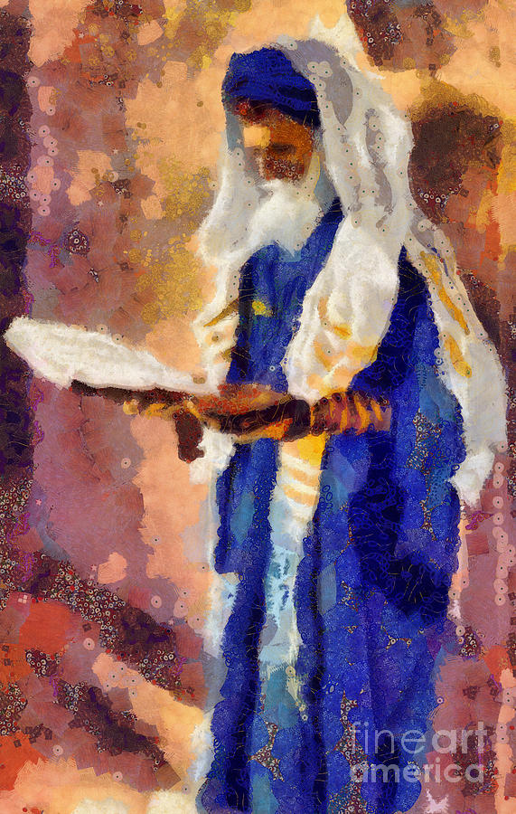
Examine the text (‘exegesis’)
Ja 1:9-10 Believers in humble circumstances ought to… But the rich should…
Ja 1:19 Everyone should be quick to listen, slow to speak and slow to become angry…
Ja 1:26 Those who consider themselves religious and yet do not keep a tight rein on their tongues deceive themselves, and their religion is worthless.
Ja 2:3 If you show special attention to the man wearing fine clothes…
James 3:1 Not many of you should become teachers, my fellow believers, because you know that we who teach will be judged more strictly. 2 We all stumble in many ways. Anyone who is never at fault in what they say is perfect, able to keep their whole body in check.

Slide 6
3 When we put bits into the mouths of horses to make them obey us, we can turn the whole animal.
4 Or take ships as an example. Although they are so large and are driven by strong winds, they are steered by a very small rudder wherever the pilot wants to go.
5 Likewise, the tongue is a small part of the body, but it makes great boasts. Consider what a great forest is set on fire by a small spark. 6 The tongue also is a fire, a world of evil among the parts of the body. It corrupts the whole body, sets the whole course of one’s life on fire, and is itself set on fire by hell.
7 All kinds of animals, birds, reptiles and sea creatures are being tamed and have been tamed by mankind, 8 but no human being can tame the tongue. It is a restless evil, full of deadly poison.

Slide 7
9 With the tongue we praise our Lord and Father, and with it we curse human beings, who have been made in God’s likeness. 10 Out of the same mouth come praise and cursing. My brothers and sisters, this should not be. 11 Can both fresh water and salt water flow from the same spring? 12 My brothers and sisters, can a fig tree bear olives, or a grapevine bear figs? Neither can a salt spring produce fresh water.

Slide 8
13 Who is wise and understanding among you? Let him show it by his good conduct, by deeds done in the humility that comes from wisdom. 14 But if you harbor bitter jealousy and selfish ambition in your hearts, do not boast in it or deny the truth. 15 Such wisdom does not come from above, but is earthly, unspiritual, demonic. 16 For where jealousy and selfish ambition exist, there will be disorder and every evil practice.

Slide 9
13 Who is wise and understanding among you? Let him show it by his good conduct, by deeds done in the humility that comes from wisdom. 14 But if you harbor bitter jealousy and selfish ambition in your hearts, do not boast in it or deny the truth. 15 Such wisdom does not come from above, but is earthly, unspiritual, demonic. 16 For where jealousy and selfish ambition exist, there will be disorder and every evil practice.
“Each of them must possess seven characteristics, as follows: wisdom, humility, fear of God, hatred of unjust gain, love of truth, respected, and of upstanding reputation.”
(Maimonides Mishneh Torah, Hilkhot Sanhedrin 2:7)

Slide 10
13 Who is wise and understanding among you? Let him show it by his good conduct, by deeds done in the humility that comes from wisdom. 14 But if you harbor bitter jealousy and selfish ambition in your hearts, do not boast in it or deny the truth. 15 Such wisdom does not come from above, but is earthly, unspiritual, demonic. 16 For where jealousy and selfish ambition exist, there will be disorder and every evil practice.
“Each of them must possess seven characteristics, as follows: wisdom, humility, fear of God, hatred of unjust gain, love of truth, respected, and of upstanding reputation.”
(Maimonides Mishneh Torah, Hilkhot Sanhedrin 2:7)
The Tongue (verses 3-12) | Unspiritual Wisdom (v. 13-16) | Wisdom from God (v. 13-16)
great boasts (v.5) | boasts or denies (v.14) | good conduct (v. 13)
A fire (v.6) | bitter jealousy (v.14) | humble (v. 13)
a world of evil (v.6) | selfish ambition (v.14) | pure (v.17)
corrupts (v.6) | earthly (v.15) | peace-loving (v.17)
untameable (v.8) | unspiritual (v.15) | gentle (v.17)
restless evil (v.8) | demonic (v.15) | accommodating (v.17)
full of deadly poison (v.8) | disorderly (v.16) | full of mercy and good fruit (v.17)
both praises and curses (v.10) | every evil practice (v.16) | impartial (v.17)
 |  | sincere (v.17)
If you want to be
a teacher…

Slide 11
13 Who is wise and understanding among you? Let him show it by his good conduct, by deeds done in the humility that comes from wisdom…
17 But the wisdom from above is first of all pure, then peace-loving, gentle, accommodating, full of mercy and good fruit, impartial, and sincere. 18 Peacemakers who sow in peace reap the fruit of righteousness.

Slide 12
17 But the wisdom from above is first of all pure, then peace-loving, gentle, accommodating, full of mercy and good fruit, impartial, and sincere. 18 Peacemakers who sow in peace reap the fruit of righteousness.
SUMMARY:
Some Believers are poor, and some are wealthy (Ja 1:9-10)
Some appear to have been talking too much, not listening to others, and causing arguments and fights (Ja 1:19)
Some want to be honoured and seen as teachers (Ja 3:1)
But if you can’t control your tongue, you are not ready to be a teacher (esp within the church) and are deceiving yourself (Ja 1:26, 3:9-16)
If you are really ‘religious’ and ready to be a teacher within the church, then show it with your words and actions, with godly wisdom and humility (Ja 3:13)

Slide 13
Application
Do you want to be respected and a leader/teacher?
Then show it with words and actions that reflect God: purity, peace, gentleness, obedience, mercy/forgiveness, bearing good fruit, whole heartedness, and sincerity.
Learn to control your tongue.
Let every man be swift to hear, slow to speak, slow to wrath, for the wrath of man worketh not the righteousness of God. ^{Ja 1:19-20}

