Slide 1

The Evangelical Tradition:
Through One Person’s Life
Matthew 28:18-20

Slide 2

The Evangelical Tradition
Through One Person’s Life
Pastor Johnson Hsu

Slide 3
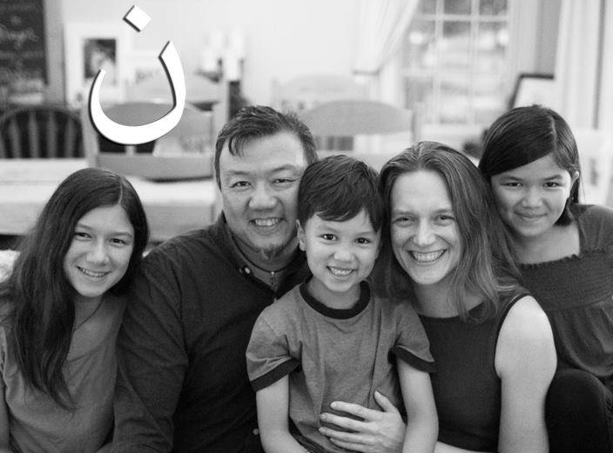

Slide 4







Slide 5
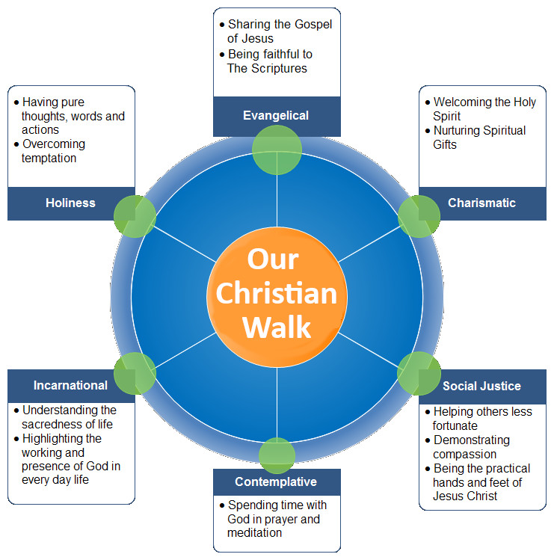
Chart derived from http://www.christcomyounity.com/values.html

Slide 6
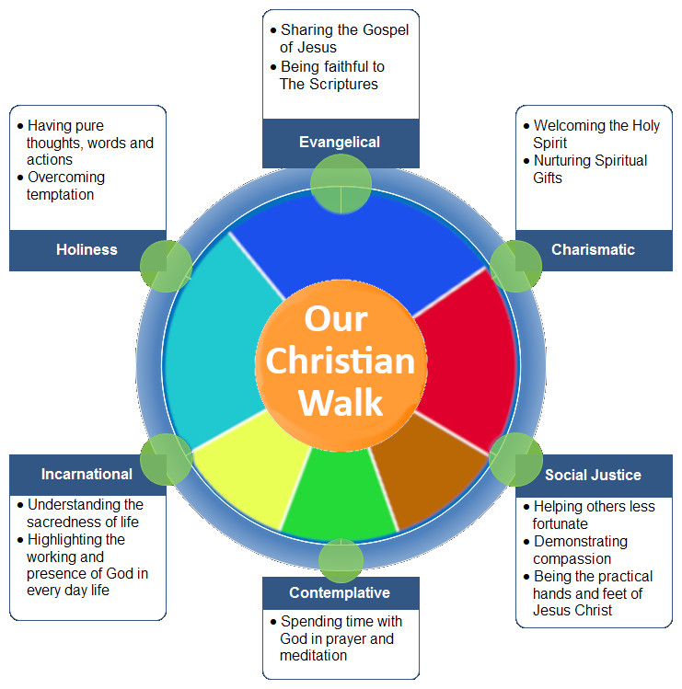
“The Evangelical Tradition is comprised of three great themes: first, and foremost, the faithful proclamation of the gospel; second, the centrality of Scripture as a faithful repository of the gospel; and third, the confessional witness of the early Christian community as a faithful interpretation of the gospel.”
Richard Foster
Chart derived from http://www.christcomyounity.com/values.html

Slide 7
“The Evangelical Tradition is comprised of three great themes: first, and foremost, the faithful proclamation of the gospel; second, the centrality of Scripture as a faithful repository of the gospel; and third, the confessional witness of the early Christian community as a faithful interpretation of the gospel.”
Richard Foster
Chart derived from http://www.christcomyounity.com/values.html

Slide 8
My ‘Evangelical Tradition’ is…
centrality of Scripture
holiness in life
following the Holy Spirit
importance of prayer
incarnational living (justice)
proclamation of the gospel
Chart derived from http://www.christcomyounity.com/values.html

Slide 9
My ‘Evangelical Tradition’ is…
centrality of Scripture
holiness in life
following the Holy Spirit
importance of prayer
incarnational living (justice)
proclamation of the gospel
Then Jesus came to them and said, “All authority in heaven and on earth has been given to Me. Therefore go and make disciples of all nations, baptizing them in the name of the Father, and of the Son, and of the Holy Spirit, and teaching them to obey all that I have commanded you. And surely I am with you always, even to the end of the age.”
^{(Mt 28:18-20)}
Chart derived from http://www.christcomyounity.com/values.html

Slide 10

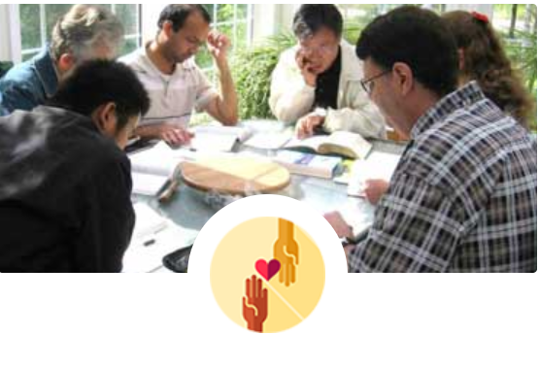



Then Jesus came to them and said, “All authority in heaven and on earth has been given to Me. Therefore go and make disciples of all nations, baptizing them in the name of the Father, and of the Son, and of the Holy Spirit, and teaching them to obey all that I have commanded you. And surely I am with you always, even to the end of the age.”
^{(Mt 28:18-20)}
Empowering international students to become fully devoted followers of Jesus, reaching out and ministering to those God has placed in their lives, whether in Canada or their home country.
Practical
&
Social Needs
Spiritual Needs
Unconditional love
www.ismc.ca National .
https://www.torontointernationalstudent.com GTA Team

Slide 11
